Slide 1


Movie Rental Test Automation

Slide 2

Architecture
Test Data
Test Case
Engine
Test Case
Engine
Test Data
Initial Script
Script
Reports
Utility Scripts
(Application)
Utility Scripts
(Common)

Slide 3
Application
Technology stack & interfaces
Test Automation infrastructure
Automation process and
reporting
Java
TestNG
Maven
BrowserStack
GitHub
Jenkins
Extend Reporting
2) Admins

Slide 4
Test Strategy
Assumptions-
Application under test is stable application
Login->
Data is stored in excel also using Data driven framework.
Login data is also store in the property file.
Action ->
We are storing data in the map and sent to UI .
We will perform task on UI.
Reporting->
We are using extent reporting.
All the logs will be saved.
In case of failures, report will save with screenshots.

Slide 5
BasePage.java-> All the reusable methods and functions are stored in the BasePage.java. BaseTest.java -> We have stored all the test cases in this file. DriverSuite.java-> All the driver compatibility has been stored in the DriverSuite.java file. BrowserStackTestNGTest.Java-> In case of multiple device coverage, we have included the browserstack compatibility. Utils folder-> We have created multiple xml files for execution in multiple scenarios. 1) browserStack.xml -> Execute tests in browserstack 2) browserstackParallel.xml-> Execute tests parallelly 3) testng.xml -> Execute tests locally
Framework Structure

Slide 6
API Testing-> We inherited rest assured framework. 1) All the GET and POST has also been verified with response code and data. 2) We have verified data on the bases of existing Payloads
Framework Structure

Slide 7
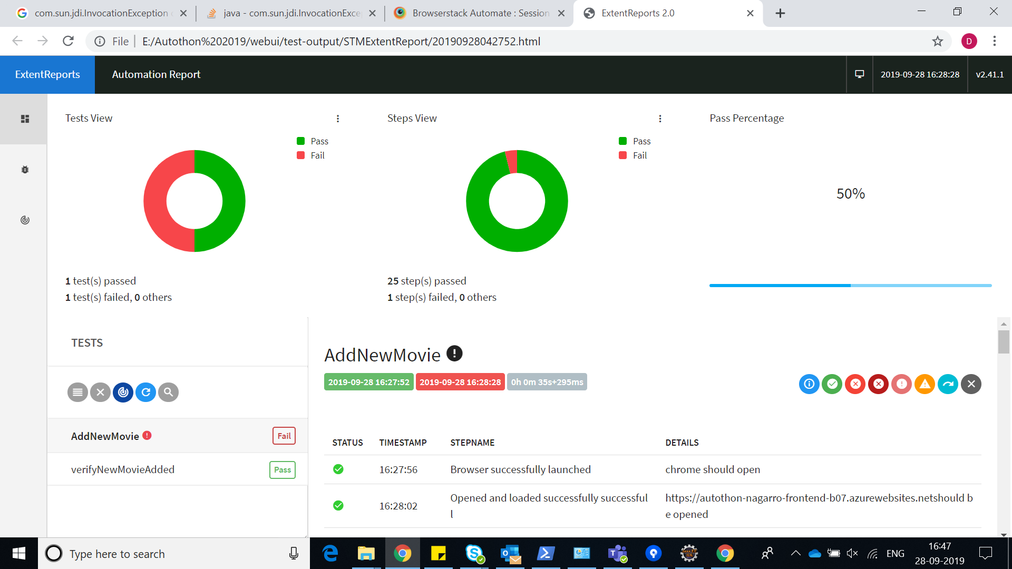
Reporting

Slide 8
Mobile Apps
A mobile app will be released. It will be a React Native app, with the same features as the web app and a couple of extra features (see below).
It will be released for the last three major releases of both iOS and Android. Tablets and mobile phones will be both be targeted.
Test Strategy->
We have added compatibility for BrowserStack in our framework.
All the last 3 versions will be added to local.config.json
All the iOS and Andriod version will be cover in the testing scope.

Slide 9
Mobile Apps
A mobile app will be released. It will be a React Native app, with the same features as the web app and a couple of extra features (see below).
It will be released for the last three major releases of both iOS and Android. Tablets and mobile phones will be both be targeted.
Test Strategy->
We have added compatibility for BrowserStack in our framework.
All the last 3 versions will be added to local.config.json
All the iOS and Andriod version will be cover in the testing scope.

Slide 10
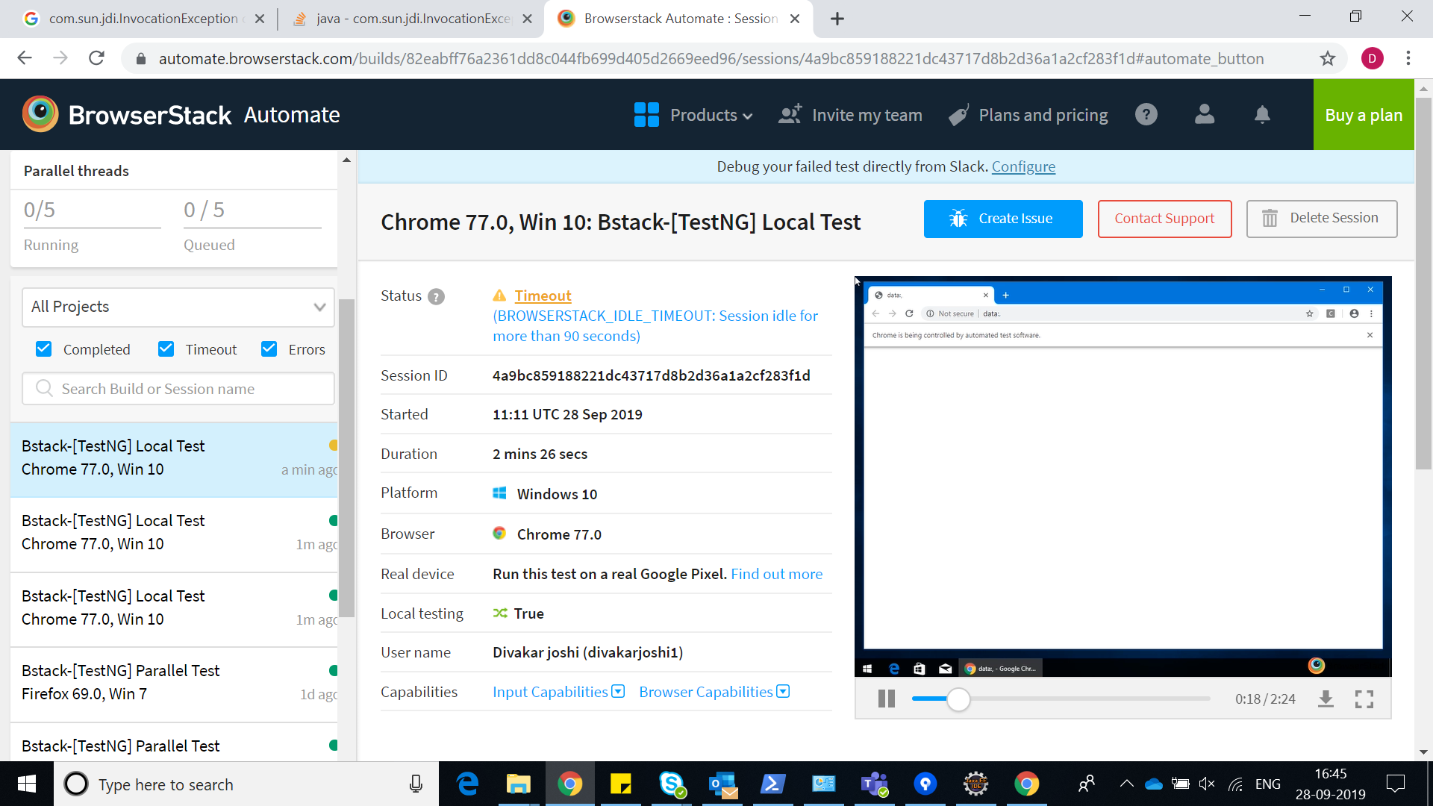

Slide 11
Data Warehouse support
Identifying data sources and requirements - At this Stage, validation of data, data sources, data quality, acceptance criteria and transformation rules is done.
Data acquisition - At this stage, validation of ETL/DW Architecture, source to target mapping, indexing, portioning will be done.
Implement business logics and dimensional Modelling - At this stage, validation of data archival and data purge strategy, error logging, exception handling and recoverability will be done.
Build and populate data - At this stage, ETL pull logic i.e. full/Incremental pull and parallel execution & precedence is validated.
Build Reports - At this stage, QA prepares the test data and ETL testing is done for all end to end scenarios. OLAP, CUBE and report testing is also done at this stage.

Slide 12
Test Strategy
Baseline- We will follow baseline analysis to compare various version of reports. We will compare the new reports with our baseline reports. To compare our reports, we choose the first report every month to set as the baseline version.
We use the baseline version to compare all subsequent analysis reports.
Type of Reports-
These are some reports which we will support but new type of reports can also be added.
Power BI
Tableau
Excel

